Slide 1

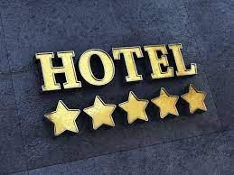
P339-Hotel Rating Classification
Team 2:
Group Members:
Rifath Yasmeen Raksha Kale Kirtee Shirsat
Bharath THORLIKONDA Srushti Patil
Havishman Ghatge Nimish Ranade Arun Kumar Singh

Slide 2
Introduction:
Briefly introduce the dataset of 20,000 reviews and ratings for different hotels.
Highlight the importance of understanding traveler experiences and preferences.
Business Objective:
Clearly state the primary goal: "To examine how travelers communicate positive and negative experiences online when staying in a specific hotel."
Emphasize the significance of uncovering the attributes that influence travelers' hotel selection.
Key Objectives:
Break down the main objective into specific goals:
Identify factors influencing positive reviews.
Identify factors contributing to negative reviews.
Understand what attributes travelers prioritize when selecting a hotel.

Slide 3
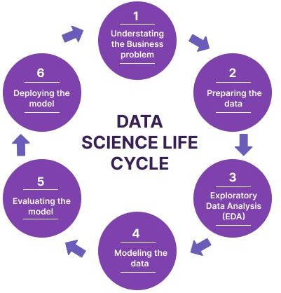
Project Workflow:
Introduction
Objective
Exploratory Data Analysis
Data Preprocessing
Model Building
Model Evaluation
Deployment

Slide 4

Libraries
Libraries
We use Python libraries such as Seaborn, Matplotlib, Pandas, Numpy, Scikit-learn, nltk and collections to preprocess the dataset and train the Model .
.
1
2
3
Source
Features
Datasets includes features such as
We are going to use a dataset comprises of roughly 20000 Reviews.
Positive and Negative Reviews
“Review” , “Rating”.Sentiment mapped into 2 class 1=Positive reviews 0=Negative reviews.

Slide 5
EXPLORATORY DATA ANALYSIS

Slide 6
Overview of the Dataset:
The dataset which consists of 20,000 reviews and ratings for different hotels.
1.Size
The dataset comprises of roughly 20000 reviews.
2. EDA
Exploratory Data Analysis is used to identify patterns and trends within the datasets.
Exploratory Data Analysis (EDA) is an approach that is used to analyze the data and discover patterns, or check assumptions in data with the help of statistical summaries and graphical representations; It can also help determine if the statistical techniques you are considering for data analysis are appropriate.

Slide 7
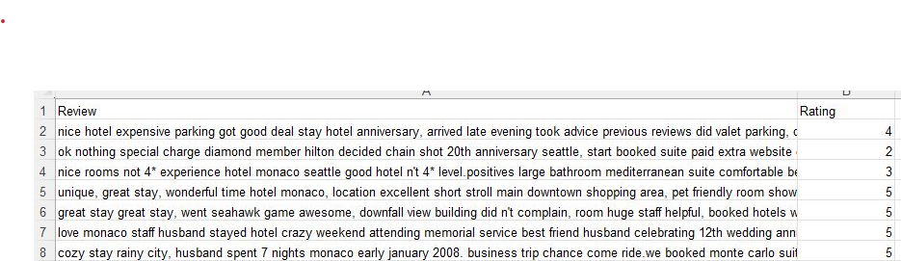
Given Dataset : Hotel_reviews

Slide 8
DATA VISUALIZATION

Slide 9
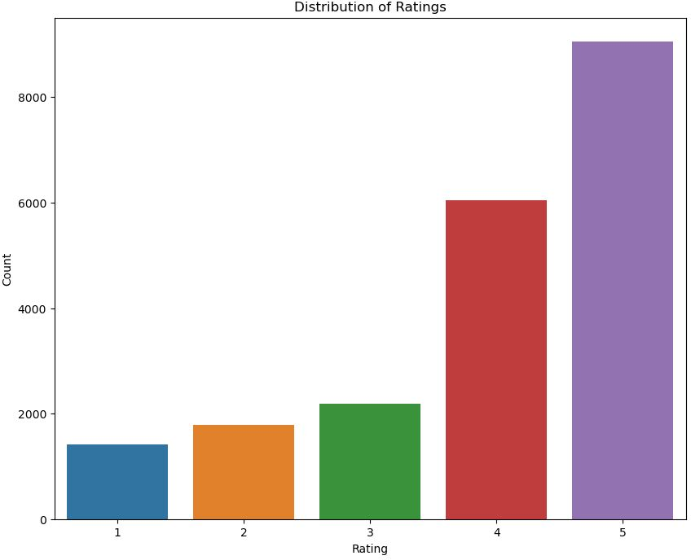
# Visualize the distribution of ratings:Most of the rating are in 4 and 5

Slide 10
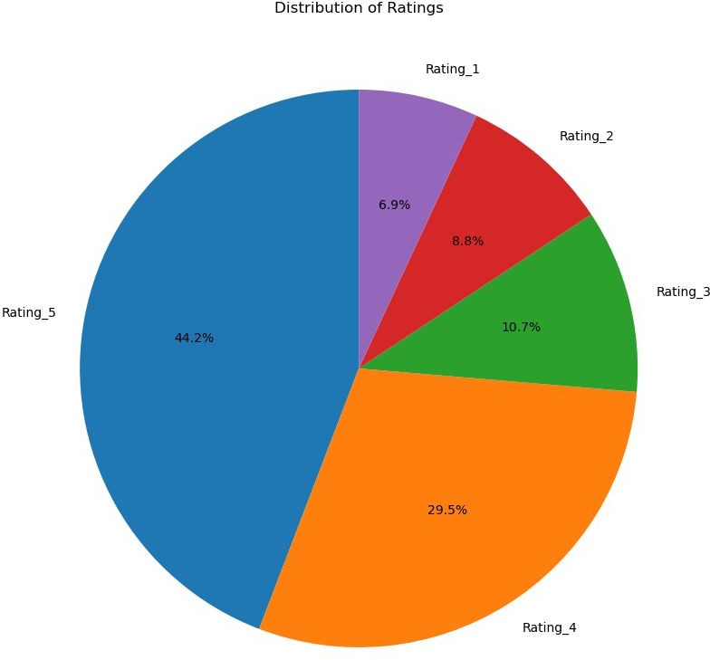
Piechart : Distribution of Ratings: Displays the percentage labels on each wedge of the pie chart
44.2 % of the people have given Rating 5
29.5% of the people have given Rating 4
10.7% of the people have given Rating 3
8.8% of the people have given Rating 2
Only 6.9 % of the people have given Rating 1

Slide 11
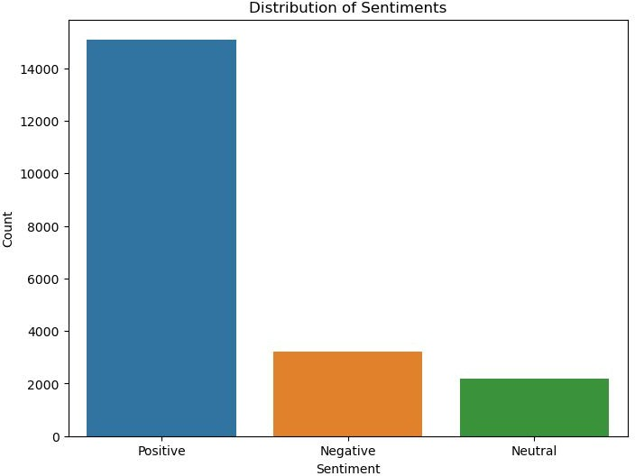
Histogram
Distribution of Ratings:Positive,Negative and Neutral

Slide 12
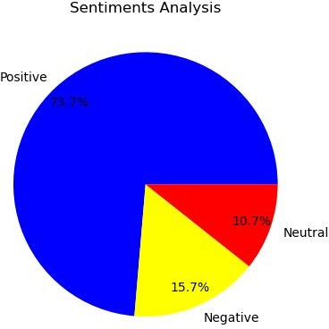
Count the number of positive , negative and Neutral reviews:
Number of Positive Reviews: 15093 Number of Negative Reviews: 3214 Number of Neutral Reviews: 2184
PIE CHART:

Slide 13
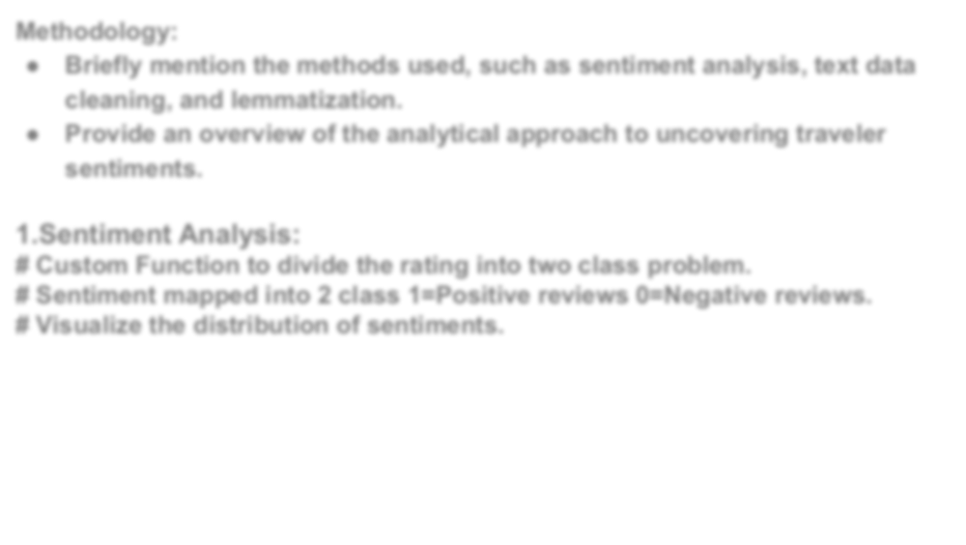
Methodology:
Briefly mention the methods used, such as sentiment analysis, text data cleaning, and lemmatization.
Provide an overview of the analytical approach to uncovering traveler sentiments.
1.Sentiment Analysis:
# Custom Function to divide the rating into two class problem.
# Sentiment mapped into 2 class 1=Positive reviews 0=Negative reviews. # Visualize the distribution of sentiments.

Slide 14
TEXT PRE-PROCESSING

Slide 15
2.Text Data Cleaning:
Introduction:
Begin by emphasizing the importance of text data cleaning in the context of your dataset.
Highlight that the quality of the text data directly impacts the accuracy and reliability of the analysis.
Why Text Data Cleaning?:
Explain that raw text data often contains noise, irrelevant information, and inconsistencies.
Clarify that cleaning the text data is essential for obtaining meaningful insights from the reviews.

Slide 16
Cleaning Steps:
Provide a high-level overview of the text data cleaning steps undertaken:
Lowercasing: Convert all text to lowercase for uniformity.
Tokenization: Break down the text into individual words or tokens.
Removing Stopwords: Eliminate common words (e.g., "the," "and") that don't contribute much to the analysis.
Lemmatization: Reduce words to their base or root form for more accurate analysis.

Slide 17
To clean textual data, we call our custom 'clean_text' function that performs
several transformations:
lower the text
tokenize the text (split the text into words) and remove the punctuation
remove useless words that contain numbers
remove useless stop words like 'the', 'a' ,'this' etc.
Part-Of-Speech (POS) tagging: assign a tag to every word to define if it corresponds to a noun, a verb etc. using the WordNet lexical database
lemmatize the text: transform every word into their root form (e.g. rooms -> room, slept -> sleep)

Slide 18
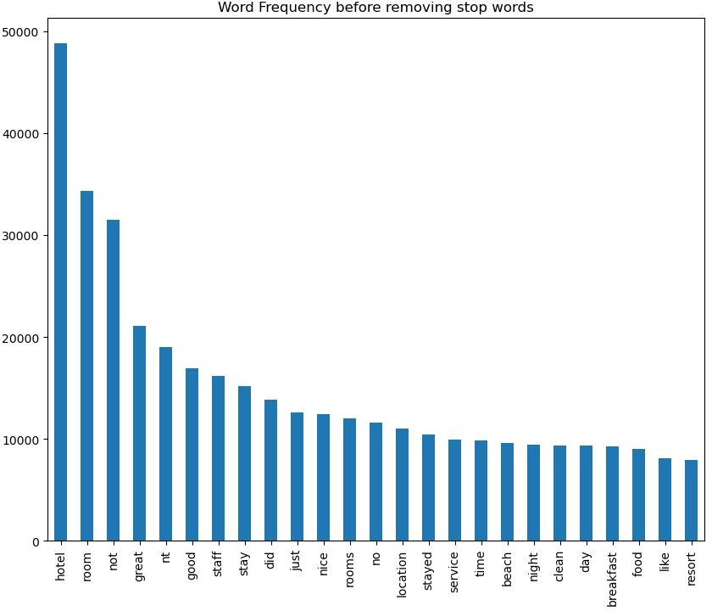
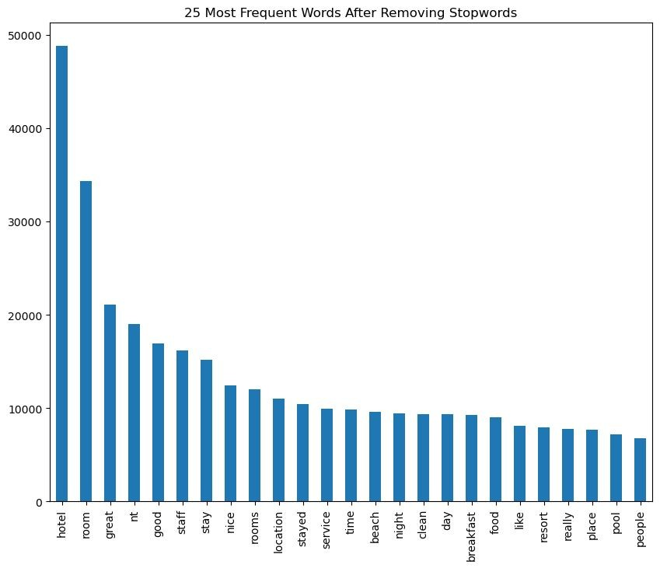
Word Frequency before Removing and after Removing Stopwords:

Slide 19
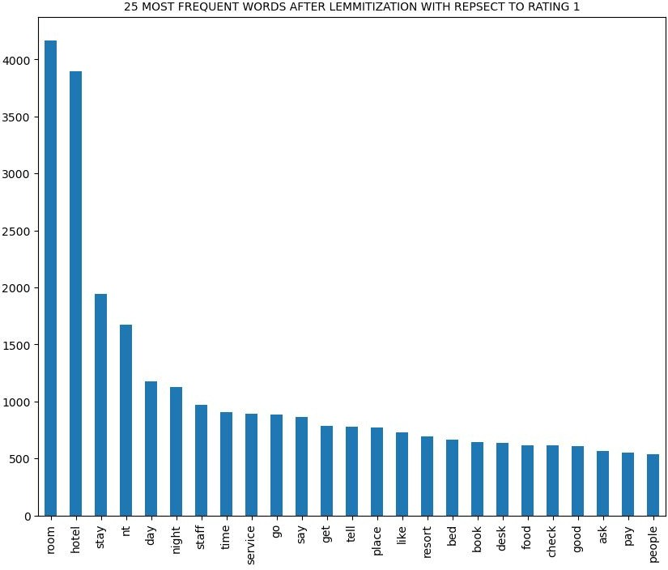
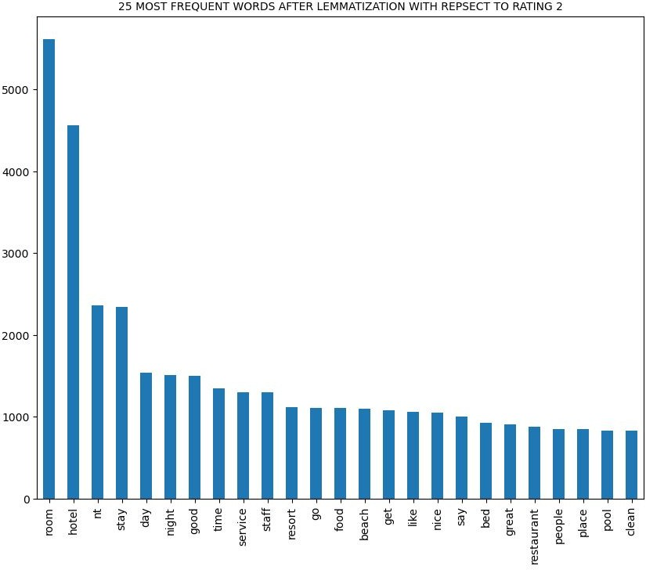
View at lemmatized data with respect to ratings:

Slide 20
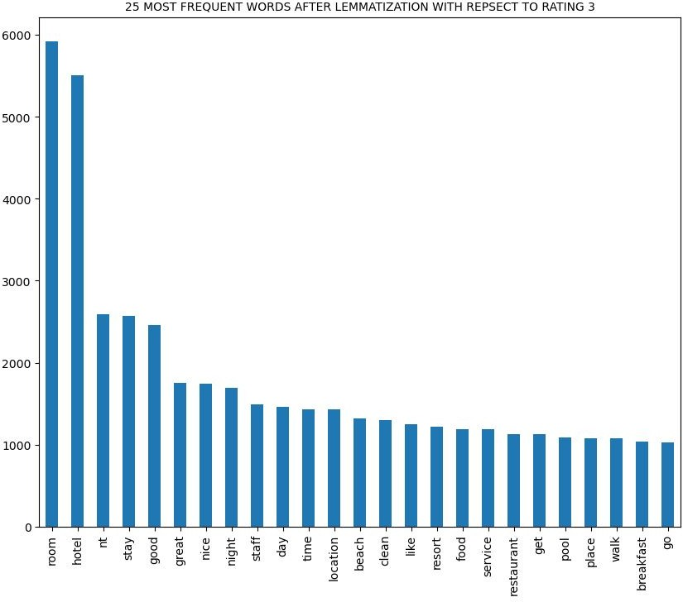
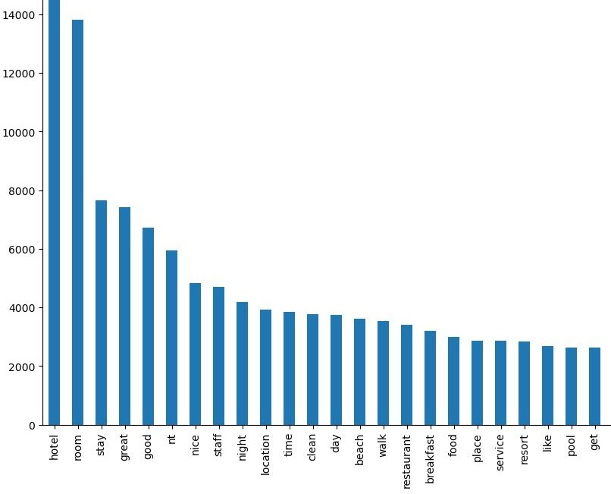

Slide 21
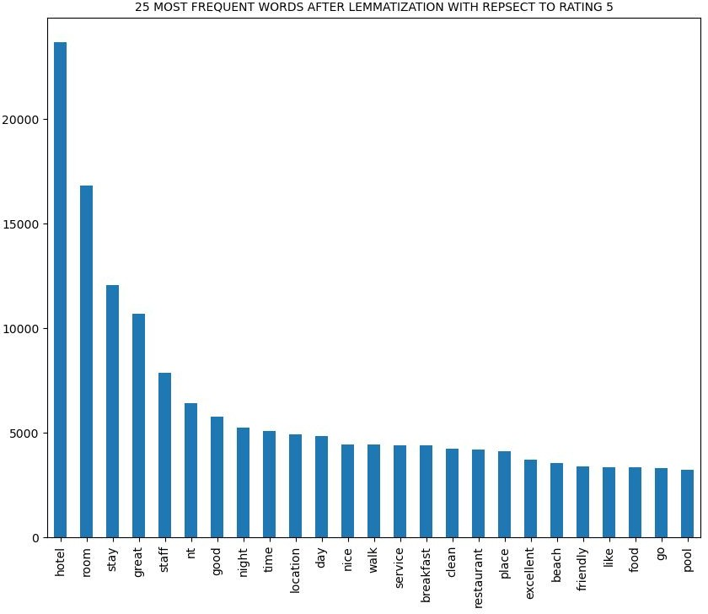

Slide 22
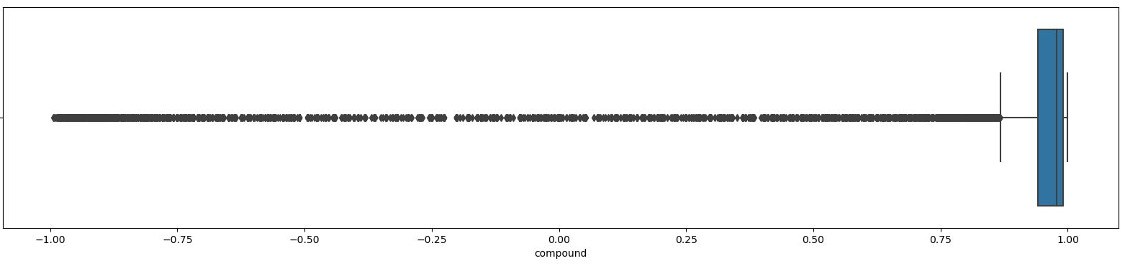
Sentiment Analysis using Vader Lexicon:
This function takes input as compound value found from Vader Lexicon and try to classify whether the review is Positive/Negative/Neutral.
BoxPlot:

Slide 23
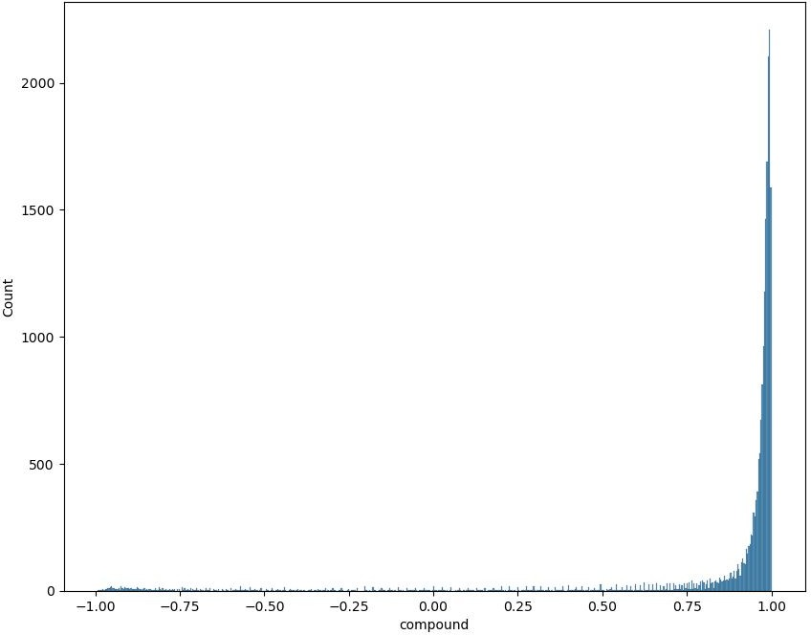
HistPlot:

Slide 24
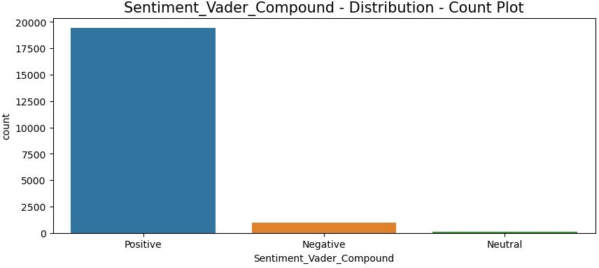
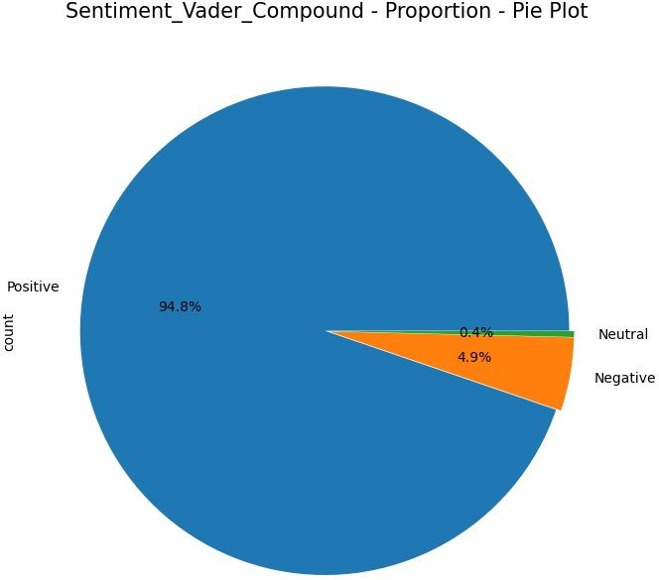
CountPlot:
PiePlot:
Positive - 94.8%
Neutral - 0.4%
Negative - 4.9%

Slide 25
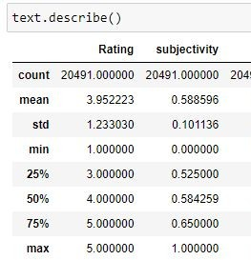
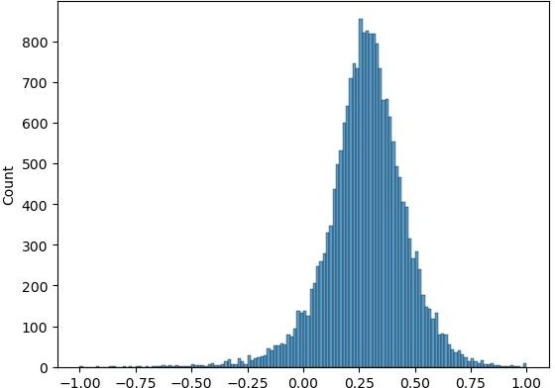
Sentiment Analysis using textblob:
HistPlot

Slide 26
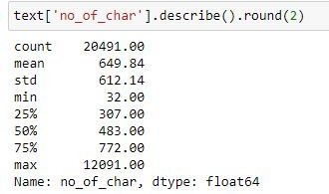
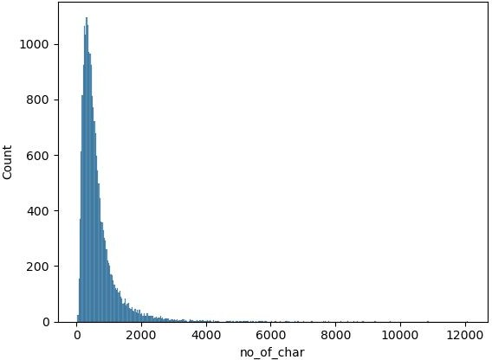
Finding Number of Characters:
HistPlot of No_of_Char:

Slide 27
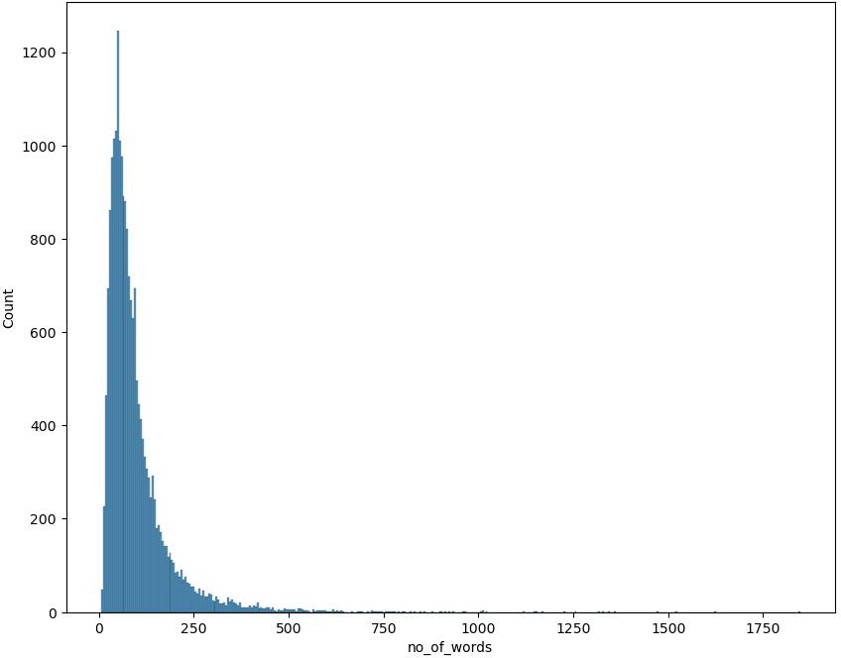
HistPlot of No_of_words:

Slide 28
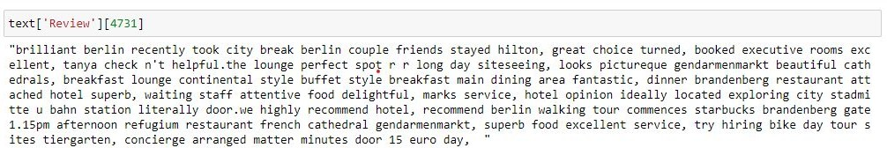
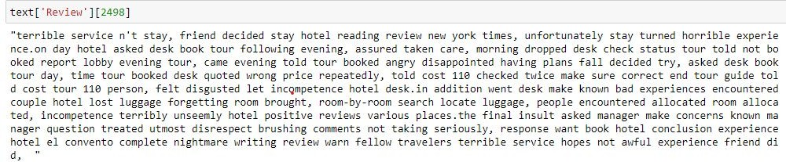
Most positive review:
Most Negative review:

Slide 29
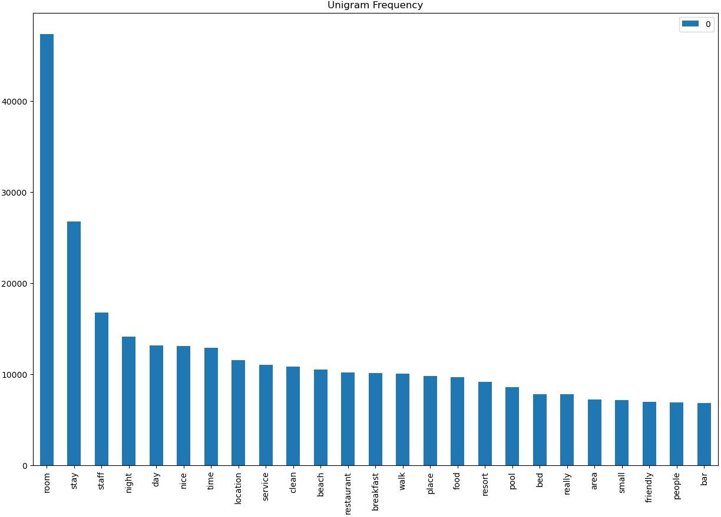
Unigrams:
Unigrams are single words or tokens extracted from a given text.’The hotel was excellent,' the unigrams would be 'The,' 'hotel,' 'was,' and 'excellent.'

Slide 30
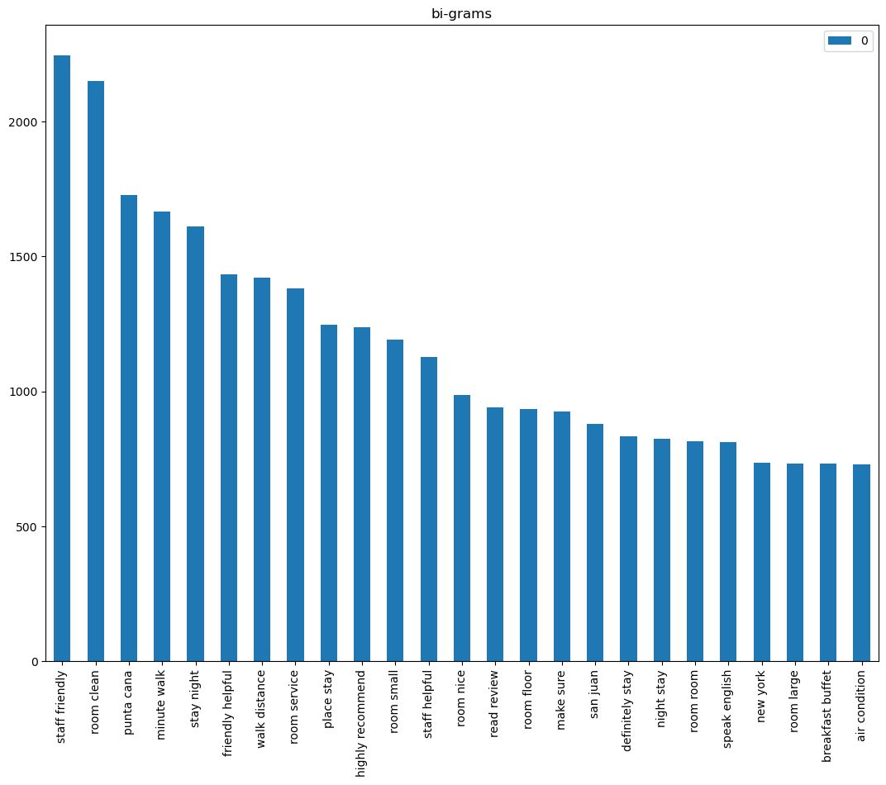
Bigrams :
Bigrams consist of pairs of consecutive words.'The hotel was excellent,' the bigrams would be 'The hotel,' 'hotel was,' and 'was excellent.

Slide 31
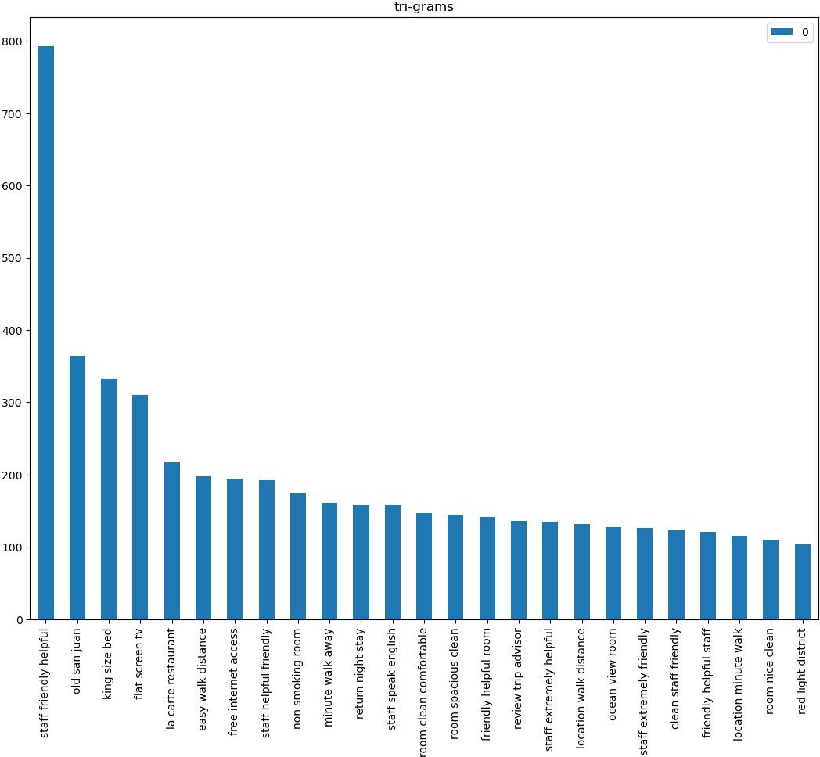
Trigrams:
Trigrams involve sequences of three consecutive words. 'The hotel was excellent' would be 'The hotel was,' 'hotel was excellent.

Slide 32
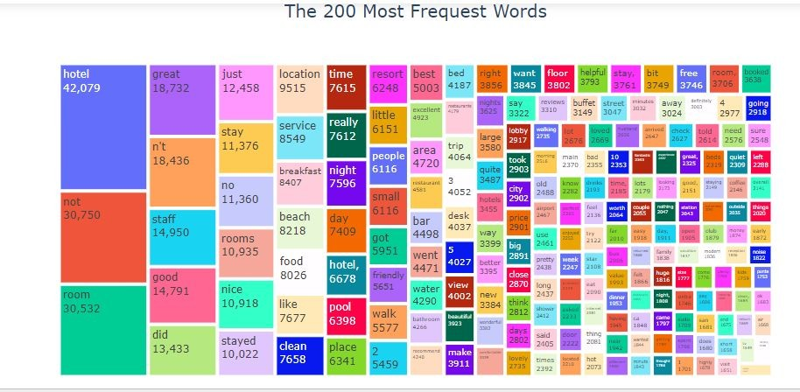
Most Used Words:

Slide 33
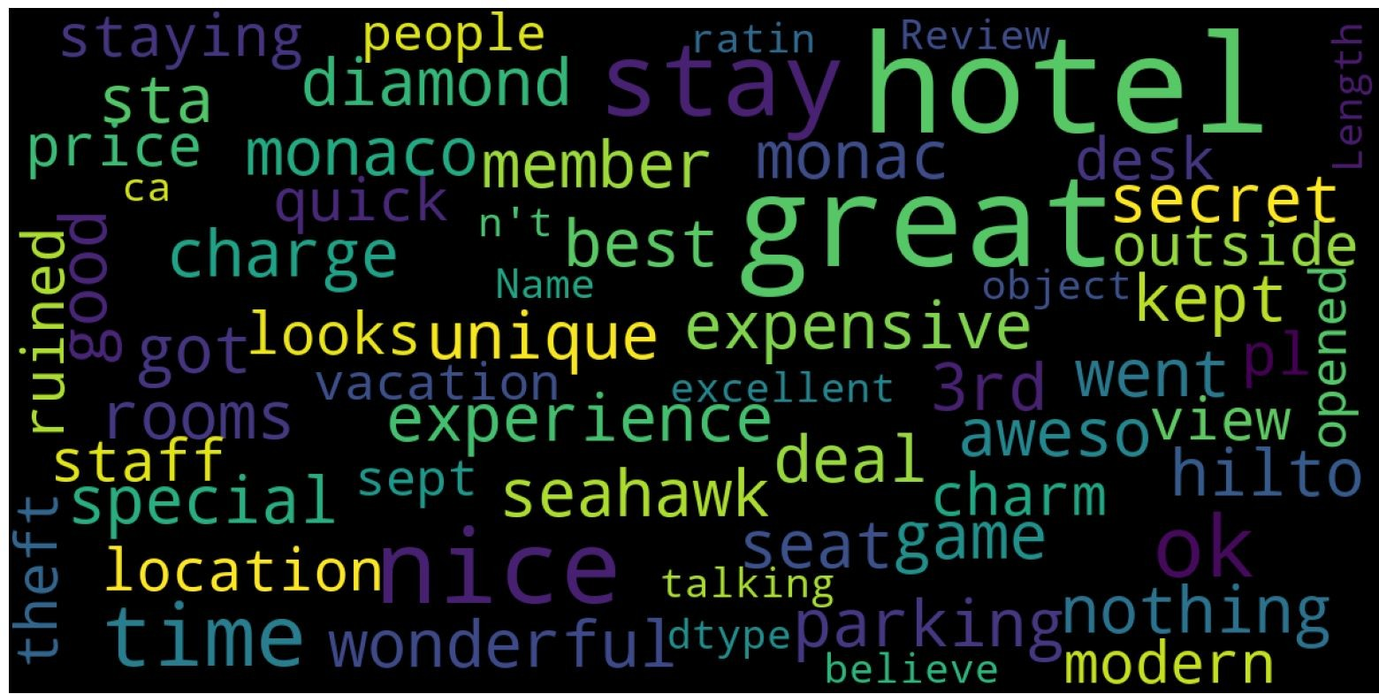
Wordcloud For All Data:Most of the words are indeed related to the hotels: room, staff, breakfast, etc. Some words are more related to the customer experience with the hotel stay: perfect, loved, expensive, dislike, etc.

Slide 34
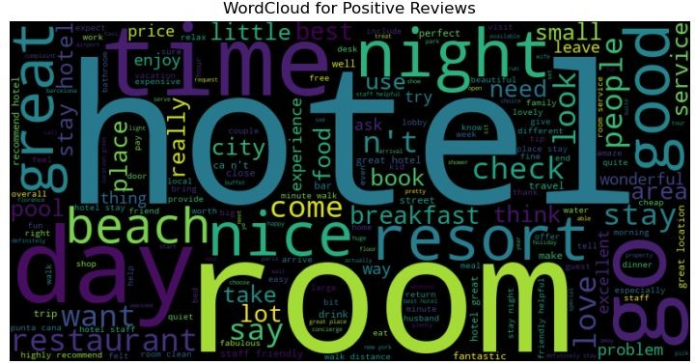
Wordcloud For Positive Reviews:

Slide 35
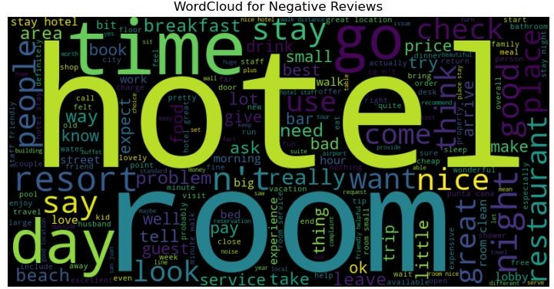
Wordcloud For Negative Reviews:

Slide 36
MODEL BUILDING
Using TF-IDF Data is converted into Structured Numerical Format
Utilized machine learning techniques to build a predictive model for identifying influential factors in hotel reviews.

Slide 37
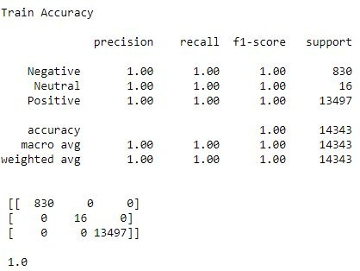
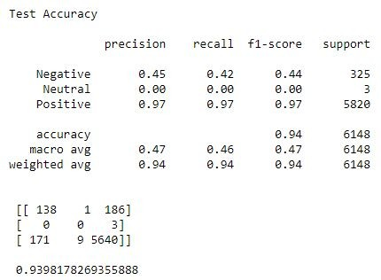
1.Decision tree classifier:

Slide 38
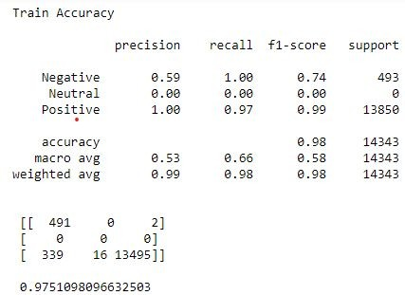
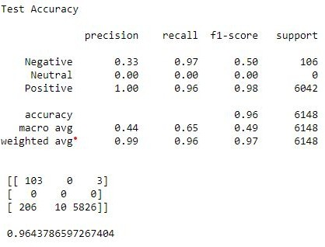
2.Logistic Model

Slide 39
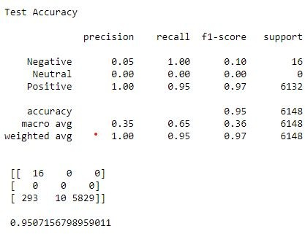
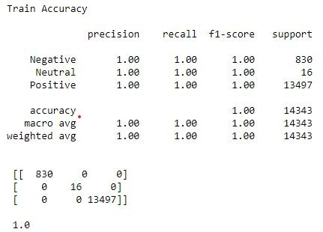
3.Random Forest

Slide 40
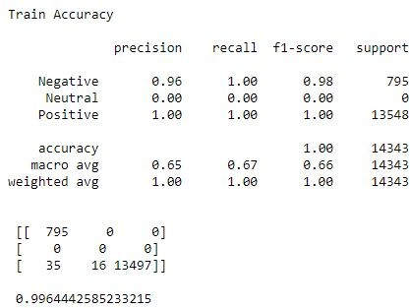
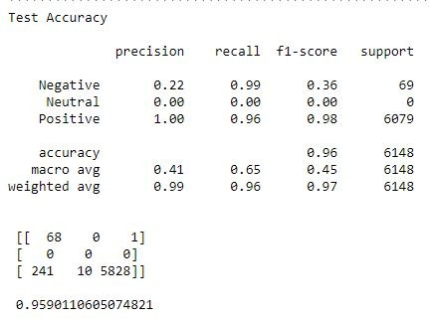
4.SVM (Support Vector Machine)

Slide 41
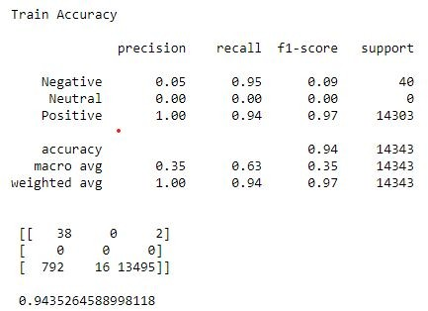
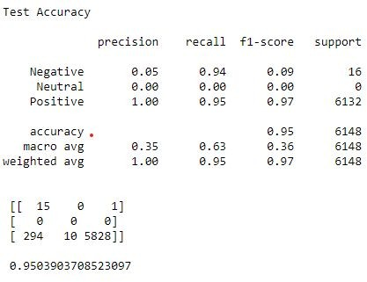
5.KNN Classifier

Slide 42
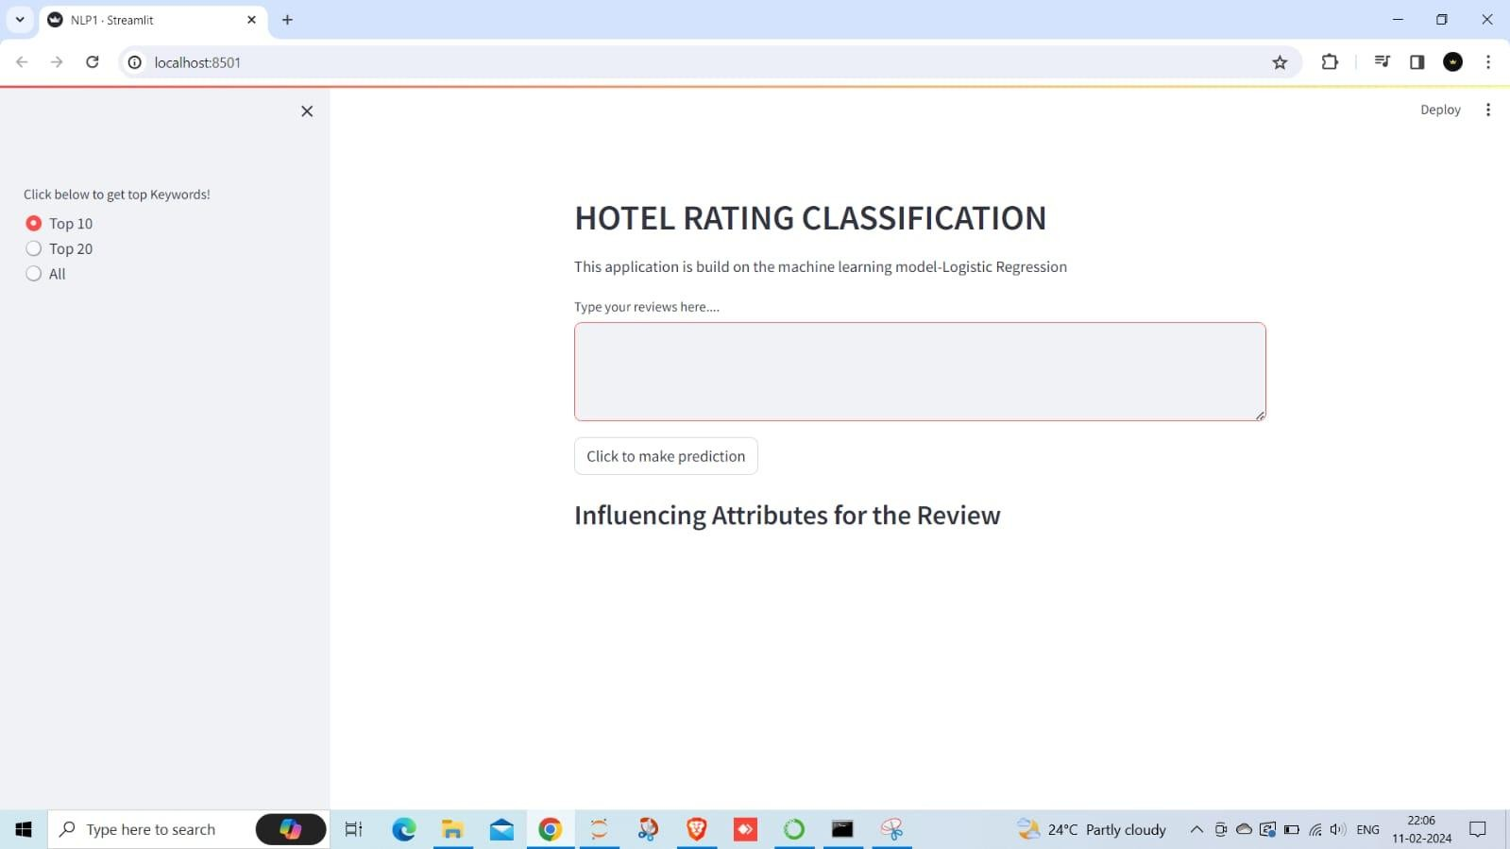
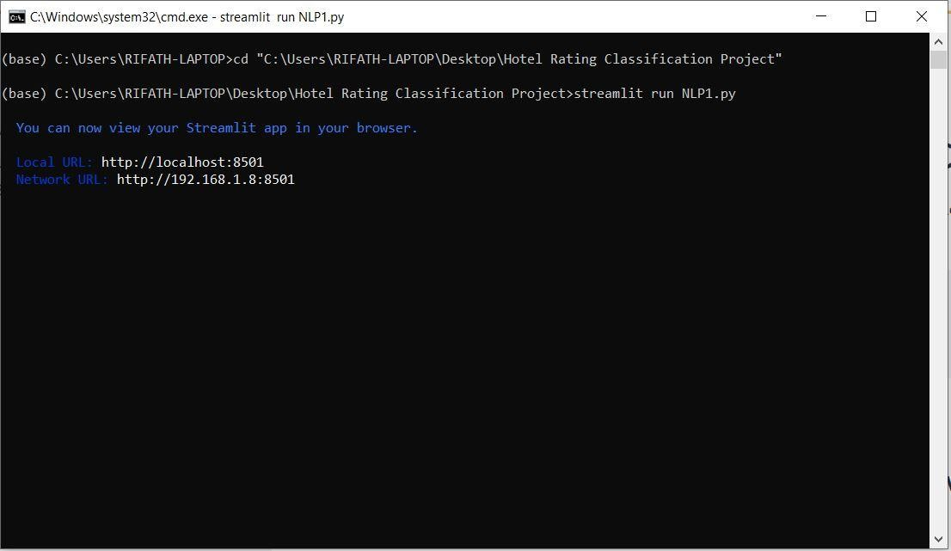
Deployment
Below are the Interface of the model deployment.

Slide 43
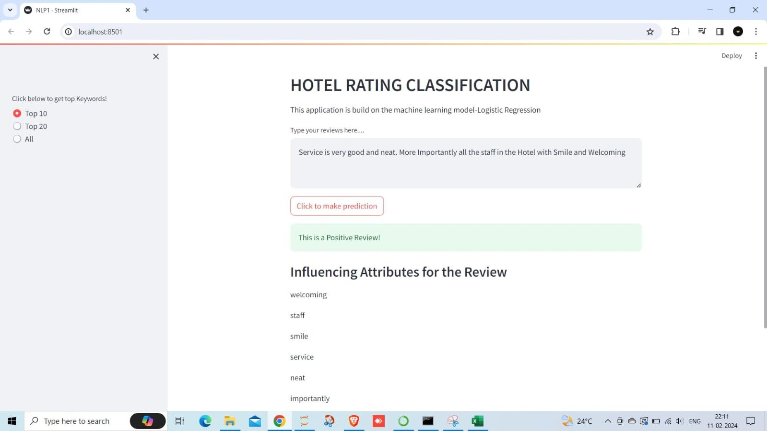
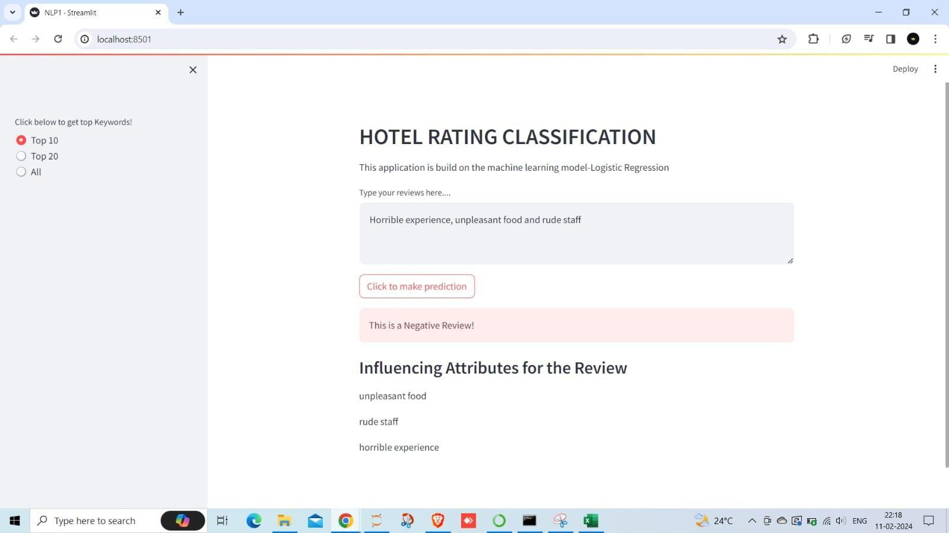
Positive and Negative Review : reviews are taken from tripadvisor website.

Slide 44
Challenges Faced and Strategies for Improving Hotel Brand Image
Understanding Travelers' Experiences and Preferences
Challenges Faced :
Understanding the nuances of travelers' sentiments.
Handling the large volume of reviews and ratings effectively.
Identifying key attributes that influence travelers' decisions.
Ensuring data accuracy and reliability.
Strategies to Overcome Challenges:
Implementing advanced sentiment analysis techniques.
Utilizing machine learning algorithms for attribute identification.
Conducting thorough data preprocessing and cleaning.
Collaborating with domain experts for insights validation.

Slide 45
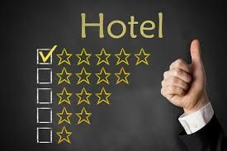
Conclusion:
By scrutinizing positive and negative experiences, we've identified critical attributes that shape guest perceptions and influence their hotel selections.
Our proposed approach achieves high accuracy and performance on different datasets.
Future work can focus on improving feature selection and augmenting data for better model performance.

